Slide 1


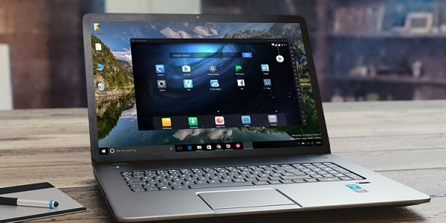
Majed hameed almutairi
Id:432105522
2004,2005 Group:
Topic:computer users

Slide 2
index
What is a computer
What are the uses of computers
What are the benefits of using a computer
What are the harms of using a computer

Slide 3
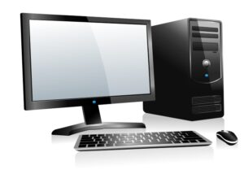
What is a computer?
This Photo by Unknown Author is licensed under CC BY-NC

Slide 4
A computer is an electronic device for processing information or data. It has the ability to store, retrieve and process data
This Photo by Unknown Author is licensed under CC BY-NC

Slide 5
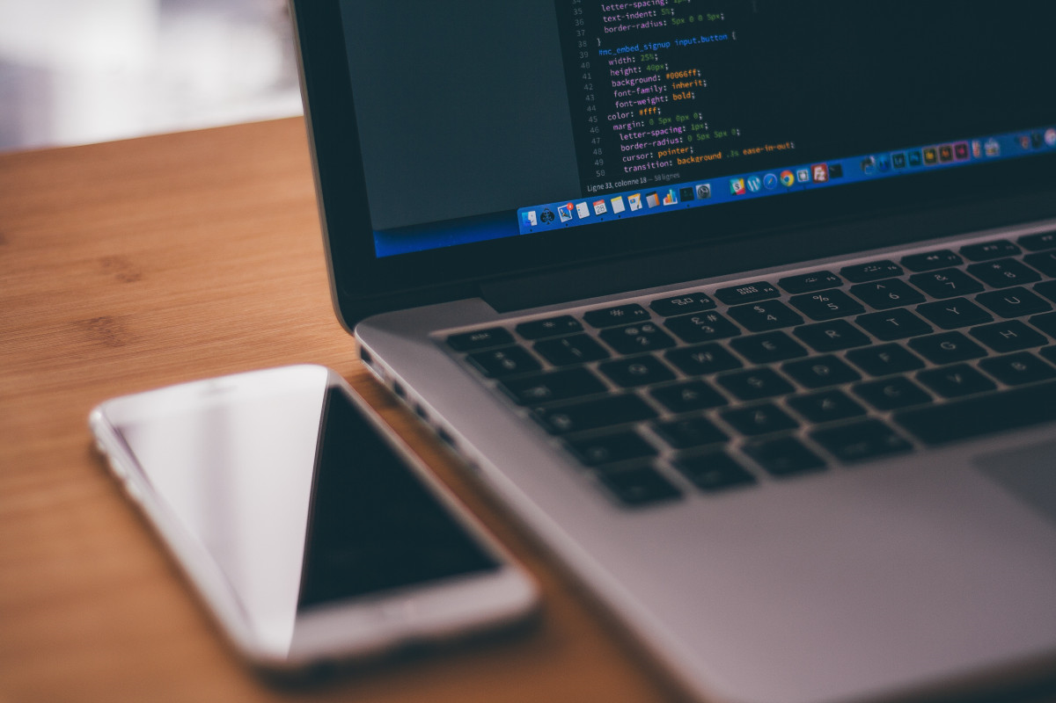
What are the uses of computers?

Slide 6

Use a computer to write documents, send e-mail, play games, and browse the web. You can also use it to edit or create spreadsheets, presentations, and even video files.

Slide 7
What are the benefits of using a computer?

Slide 8
Facilitating ways to communicate with others through editing and writing messages, and preparing reports and documents. An effective element in achieving success in work as well as education. A major tool in distance education, this type of education cannot be completed without the presence of a computer

Slide 9
What are the harms of using a computer?

Slide 10
Addiction
Social isolation
Health effects
Violation of privacy

Slide 11
Thank you for attention and listening

